Slide 1
The Friar
Claudia Cudoni
Hailie Bishop

Slide 2
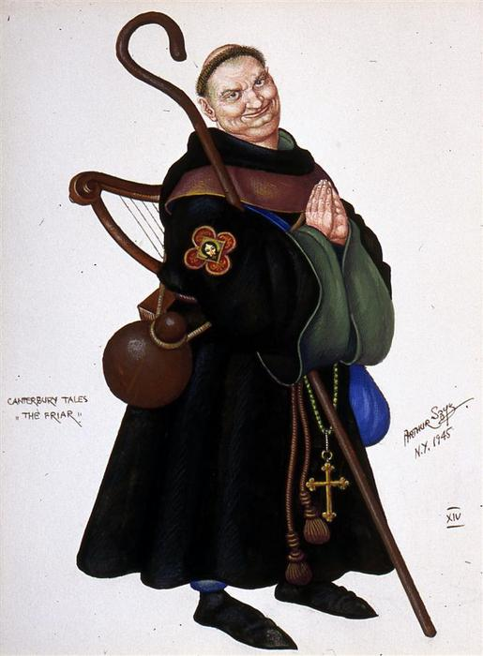
What did he look like?
He is a strong and powerful man
Yet, he is pale, which means he is higher in society
Chaucer says that his eyes twinkle, so that could mean that he is doing something that brings him joy.
“His neck was whiter than a lily-flower, But strong enough to butt a bruiser down.”

Slide 3
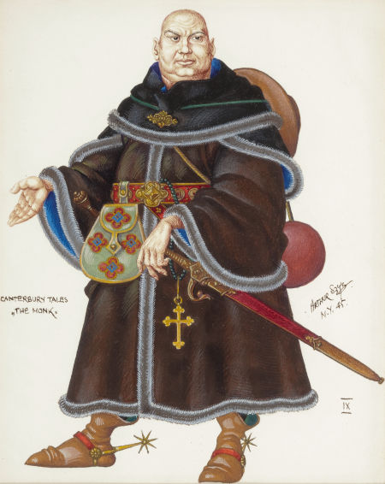
How is he dressed?
He carries a tippet full of pins for curls
A pouch full of bobby pin like thing
His cape was double wool and swopped around as a newly merged bell
Carries around pocket knives to give to pretty girls
He was very flirtatious, giving weird gifts to women he liked.
He was well dressed, like nobility.
Even though he lived a life of poverty.

Slide 4
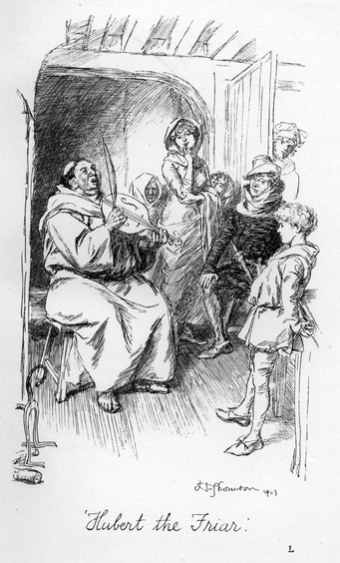
How did he talk?
Talked well…
He spoke fast and with great English
Educated speaker
Smooth talker
Could convince anyone of anything
He was a great singer with a booming voice
“And certainly his voice was gay and sturdy, For he sang well and played the hurdy-gurdy. At sing-songs he was champion of the hour.”

Slide 5
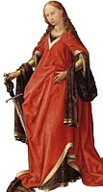
Random Facts
He would get women pregnant then merry them off to noble boys as penance
He had permission from the pope to take confessions
His name was Hubert

Slide 6
Did Chaucer think highly of the character?
Yes… and no
He respected him enough to learn his name
But... He describes him as a drunk and says he is not doing his job to the best of the ability.
“He knew the taverns well in every town, And every innkeeper and barmaid too”
“ But only with the rich and victual-sellers. But anywhere a profit might accrue, Courteous he was and lowly of service too. Natural gifts like his were hard to match. He was the finest beggar of his batch, And, for his begging-district, paid a rent”

Slide 7
Is Chaucer presenting a Satire of the character?
Yes
The way he describes how he went about in his day to day life it shows irony because a Friar should not conduct himself in that way.
“Better than lepers, beggars and that crew, For in so eminent a man It was not fitting with the dignity Of his position, dealing with a scum Of wretched lepers; nothing good can come Of commerce with such slum-and-gutter dwellers, But only with the rich and victual-sellers.”
“He was the finest beggar of his batch, And, for his begging-district, paid a rent; His brethren did no poaching where he went. For though a widow mightn’t have a shoe, ”

