Slide 1
The Cook
The Canterbury Tales

Slide 2
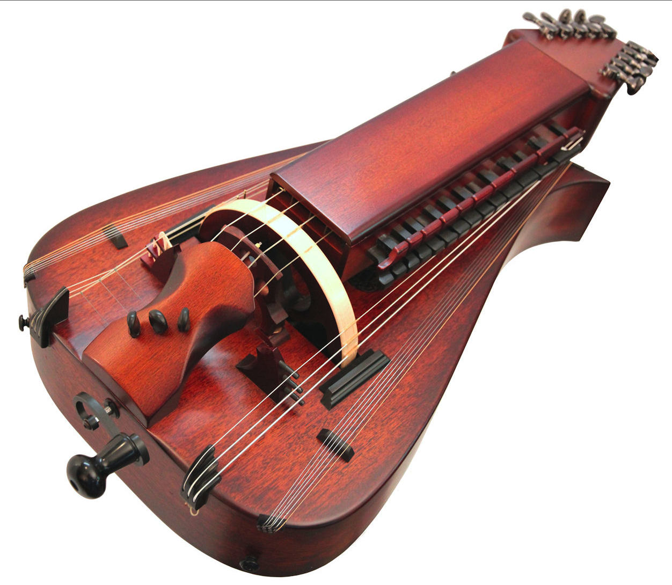
Perkyn Revelour
Last name, “Revelour” meaning that he likes to party
Reveler – a person who enjoys themselves in a playful and loud way
“Joyful like a song bird”
Likes to be at the bar rather than working
Likes dancing and singing
Loves flirting and drinking
Good at gambling
Plays the hurdy gurdy
Cook
Cooks for the pilgrims

Slide 3
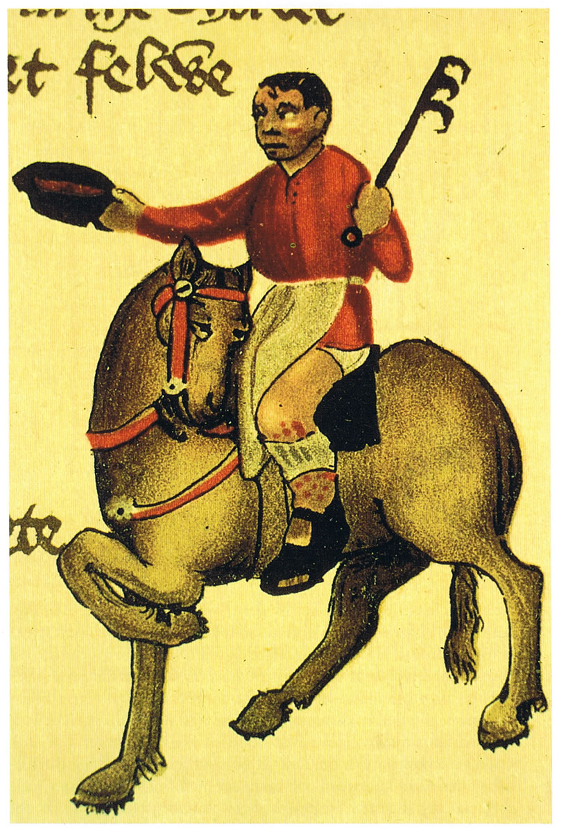
Perkyn Revelour
Physical appearance:
Short
Good looking
Nice tan
Black hair
Not very hygienic.
Poor…but…for a logical reason…
Social standing was not very high ranked
Tried to gain attention in a negative way
Didn’t treat women very well
Flirting constantly
“Who makes a practice out of dicing, debauchery, or womanizing.”

Slide 4
Not as good a man as we thought…
Freely spent money on luxury items for himself
Gambled nonstop
“For in the town there was no apprentice That could better throw a pair of dice.”
Actually had a wife, but used her more as a “social status”
“And had a wife that he kept for the sake of appearance”

Slide 5
You had one job…
Byeeeee!
He would go to jail sometimes
“And sometimes taken (as a prisoner) to Newgate prison
Master eventually heard about his sinful behavior
Knew that because of his money spending habits, he would make things worse.
Master fired him from his cooking job
Another cook took his job
…And you screwed it up.

Slide 6
What does that Chaucer think of the Cook?
Chaucer doesn’t really care much about the cook to be honest!
Gives little detail
Very little emphasis
Describes the cook as being an alcoholic and unclean
“He could distinguish London ale by flavor”
“That he should have an ulcer on his knee…”
Probably more of a supporting role, because a cook has to exist.

